Slide 1
Prerequisites and setup steps
WIFI Connection Instructions: Connect to the wireless network MSFTGUEST. Open a browser and navigate to a web site (www.bing.com) to be redirected to the Captive Portal. Click on Event Attendee Code and enter the access code: msevent553yg
If you have trouble with your browser redirecting, type this URL: http://aka.ms/guesteventcode
Install Visual Studio 2017 or VS Code
Download material from https://InsightDI.github.io/biad/
Gain access to Azure. Get an account from Keith (presenter) if needed. If using one of ours, the piece of paper contains the username and password. To log in, go to https://portal.azure.com/. The username will be the first column of your sheet of paper, plus @CSGTraining.onmicrosoft.com.

Slide 2
Bot in a Day
Keith Wood
Principal Consultant, Intelligent Applications

Slide 3
Agenda
8:30-9:15: Setup
9:15-10: Introduction to AI and Intelligent Bots
10-11: Lab 1: Language Understanding Intelligent Service (LUIS)
11-12: Lab 2: Azure Search
12-1: Lunch
1-3: Lab 3: Building Intelligent Bots
3-4: Lab 4: Bing Search
4-5: Q&A

Slide 4




Creating meaningful connections that help businesses run smarter.
Supply Chain Optimization
Cloud & Data Center Transformation
Digital Innovation
Connected Workforce
We help you invest smarter so you can manage today and transform the future.
We create a connected workplace so employees can work smarter.
We help you prepare for the future and align workloads to the right platforms.
We help you innovate smarter so you can make meaningful connections.

Slide 5

Digital Innovation
Empower Workforce
Friction-free tool to maximize employee effectiveness
Engage Customers
Rethinking how companies connect with their customers.
Optimize Business
Operational optimization driven by information

Slide 6









Pillars of Digital Innovation
Cloud Enablement
Data & AI
DevOps
Digital Strategy
Intelligent Applications
IoT and Smart Edge
Transformation Services
Digital Experience provides winning solutions that engage customers and employees in new, meaningful ways.
Disruptive Technology Innovations, both proven and emerging, captivate customers, empower employees and transform business operations.
Continuous Services sustains innovation with strategy, support, delivery, and data-driven insights.
DI

Slide 7


Awards
2018
Worldwide Artificial Intelligence Partner of the Year
Worldwide Modern Workplace Partner of the Year
U.S Partner Award for Apps and Infrastructure – DevOps
U.S. Partner Award for Data & AI – Internet of Things
U.S Partner Award for Apps & Infrastructure – Open Source Apps and Infrastructure on Azure
2017
Worldwide Mobile Application Development Partner of the Year
Worldwide Open Source on Azure Partner of the Year
U.S. NSP Partner of the Year (and runner up)
U.S. FED Partner of the Year
U.S. EDU Partner of the Year
2016
Worldwide Internet of Things Partner of the Year
U.S. FED Partner of the Year
OEM Device Partner of the Year
Our combined IT industry knowledge and technology expertise have earned us numerous Microsoft honors through the years.
Notes:
Use awards that are appropriate for your audience

Slide 8
What is a Conversational Agent

Slide 9

“
Conversational Agents are artificial intelligence computer programs that communicate with people using natural language.

Slide 10



Why Now?
Machine Learning Capacity
Digital Assistants
Open Messaging Platforms
Machine Learning in the cloud
Tensor Flow/CNTK
SciKit/Keras/etc
Siri
Alexa
Google Assistant
Cortana
Facebook Messenger
Slack
Microsoft Teams
Symphony
Skype for Business

Slide 11






Why Should You Care?
Demographic Shift
Millennials favor experiences that are personalized, customized, and context-sensitive.
Natural Language Interaction
Interacts with humans via voice or chat, with no learning curve.
Digital Property Integration
Expose AI through existing distribution channels (i.e. Web, Mobile, Social).
Ultimate Brand Ambassador
Consistency in tone, message, and script.
Push vs Pull
Targeted contextual, personalized communication to the right user at the right time.

Slide 12
BREADTH Microsoft AI Platform: Azure + AI
AI SERVICES
AI TOOLS
CONVERSATIONAL AI
AI MODULES
DEVICES
Azure Bot Service
Cognitive Services
Azure IOT Edge
CODING & MANAGEMENT TOOLS
VS Tools for Machine Learning
Azure ML Studio
Azure ML Workbench
AI INFRASTRUCTURE
Others (Pycharm, Jupyter notebooks…)
AI ON DATA
AI COMPUTE
DEEP LEARNING FRAMEWORKS
Cosmos DB
SQL
DB
SQL
DW
Data Lake
Spark
DSVM
Batch AI
ACS
Edge
Cognitive Toolkit
TensorFlow
Caffe
CPU, GPU, FPGA
Others (Scikit-learn, MXNet, Keras, Gluon…)

Slide 13

AI resources Get started
Cognitive Services azure.com/cognitive
Azure Bot Service azure.com/bots
Machine Learning & Deep Learning aka.ms/mldeeplearning
OPPORTUNITIES
Get Started Guides aka.ms/csdoc
Azure Bot Service Quickstarts aka.ms/botquickstart
AI School aischool.microsoft.com/
AI Show channel9.msdn.com/Shows/AI-Show
Notes:
Confluence of cloud, data and AI is at the core of enabling the Microsoft mission of empowering people and organizations to achieve more
New insights from data, driven by advances in AI and powered by cloud, are the catalysts to augment the human ingenuity, removing friction and driving innovation
We want to empower today’s innovators to use data to reimagine products and experiences that will improve our world

Slide 14





Why a bot?
TYPE
TALK
TAP
Bot builder
Cortana
Facebook Messenger
Skype
Platform services
Intelligent tools
Bing
Notes:
More natural human / computer interaction
Appealing. Efficient. Easy. Natural.
Adapts to the user depending on circumstance
Available where you are (Web, Mobile, Car, Desktop, …)

Slide 15
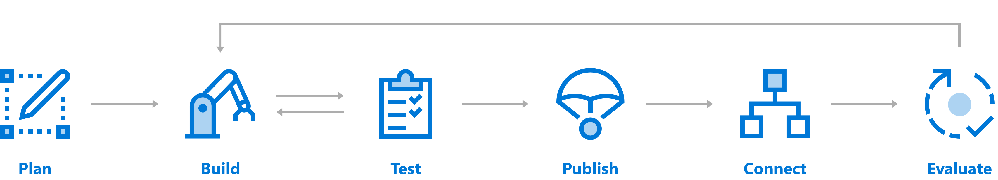




Create a Conversation with Bot Service Comprehensive framework for the lifecycle of your project
Author Dialogs
Design Cards
Visualize
Bot Builder SDK
Cognitive Services
Getting Started Templates
Emulator​
Application Insights
Emulator
DevOps Tools
Azure
BYO Web Host
WebChat
Cortana
Skype
Facebook
…
Application Insights
LUIS Suggestions

Slide 16
Demo
Litware Insurance
Notes:
https://insurance.litwaredemos.com/
Litware Insurance Bot Demo
User: Bot
Password: Azure

Slide 17
Understand Technology Capability
Notes:
In this section, you will explore the steps required to conduct effective design research, including:
1. Microsoft Bot Framework Capabilities
2. Supporting technologies

Slide 18







Why Microsoft Cognitive Services ?
Easy
Flexible
Tested
Roll your own with REST APIs
Simple to add: just a few lines of code required
Make the same API code call on iOS, Android, and Windows
Integrate into the language and platform of your choice
Built by experts in their field from Microsoft Research, Bing, and Azure Machine Learning
Quality documentation, sample code, and community support
GET A KEY
BUILD
Notes:
With Cognitive Services, you can infuse your apps, websites and bots with intelligent algorithms to see, hear, speak, understand and interpret your user needs through natural methods of communication.
Transform your business with AI today.
Reference:
https://azure.microsoft.com/en-gb/services/cognitive-services/

Slide 19


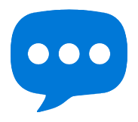
Microsoft Cognitive Services
Give your apps a human side
Vision
From faces to feelings, allow your apps to understand images and video
Speech
Hear and speak to your users by filtering noise, identifying speakers, and understanding intent
Language
Process text and learn how to recognize what users want
Knowledge
Tap into rich knowledge amassed from the web, academia, or your own data
Search
Access billions of web pages, images, videos, and news with the power of Bing APIs
Labs
An early look at emerging Cognitive Services technologies: discover, try & give feedback on new technologies before general availability

Slide 20
Microsoft Cognitive Services
Give your apps a human side
Computer Vision
Content Moderator
Emotion
Face
Video
Video Indexer
Custom Vision Service
Bing Speech
Speaker Recognition
Custom Speech Service
Bing Spell Check
Linguistic Analysis
Text Analytics
Translator Text & Speech
Web Language Model
Language Understanding
Academic Knowledge
Entity Linking
Knowledge Exploration
Recommendations
QnA Maker
Custom Decision Service
Bing Autosuggest
Bing Image Search
Bing News Search
Bing Video Search
Bing Web Search
Bing Entity Search
Bing Custom Search
Project Prague (gesture)
Project Cuzco (events)
Project Johannesburg (routing)
Project Nanjing (isochrones)
Project Abu Dhabi (distance matrix)
Project Wollongong (location)
Vision
Speech
Language
Knowledge
Search
Labs

Slide 21
Microsoft Cognitive Services
Give your apps a human side
Vision
Speech
Language
Knowledge
Search
Labs
Computer Vision
Content Moderator
Emotion
Face
Video
Video Indexer
Bing Speech
Speaker Recognition
Bing Spell Check
Linguistic Analysis
Text Analytics
Translator Text & Speech
Web Language Model
Academic Knowledge
Entity Linking
Knowledge Exploration
Recommendations
QnA Maker
Bing Autosuggest
Bing Image Search
Bing News Search
Bing Video Search
Bing Web Search
Bing Entity Search
Project Prague (gesture)
Project Cuzco (events)
Project Johannesburg (routing)
Project Nanjing (isochrones)
Project Abu Dhabi (distance matrix)
Project Wollongong (location)
CUSTOMIZATION
Custom Vision Service
Custom Speech Service
Language Understanding
Custom Decision Service
Bing Custom Search

Slide 22
Microsoft Cognitive Services Customization
The broadest set of custom AI services available, allowing customers to use their own data with algorithms that are customized for their specific needs.
Vision
Speech
Language
Knowledge
Search
Labs
Customizable web service that learns to recognize specific content in imagery
Fine-tune speech recognition for anyone, anywhere
Teach your apps to understand commands from your users
Create custom experiences with adaptive, contextual decision-making
Create a highly-customized web search experience
Custom Vision Service
Custom Speech Service
Language Understanding
Custom Decision Service
Bing Custom Search

Slide 23
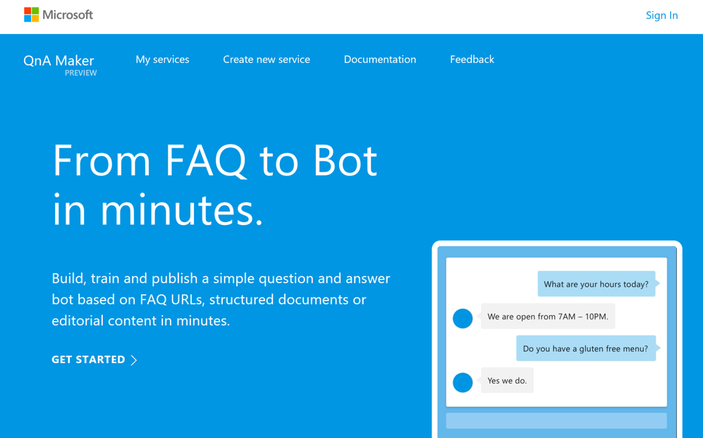
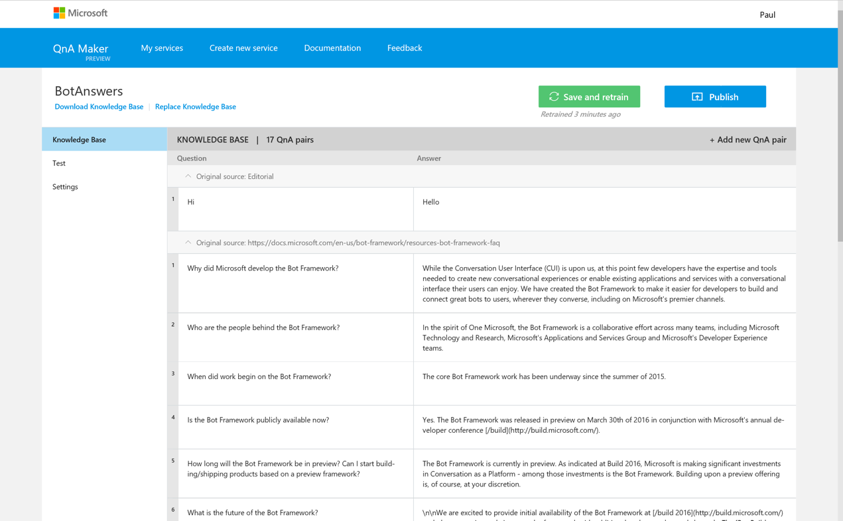
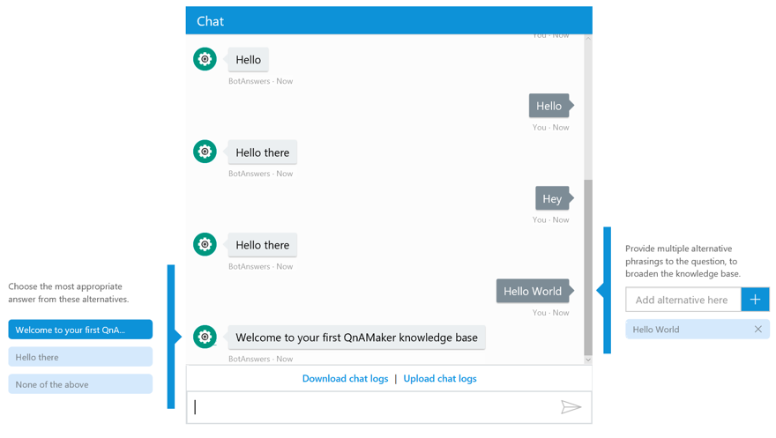
BUSINESS USER ACCESSIBILITY QnA Maker
Distill information into conversational, easy-to-navigate answers

Slide 24
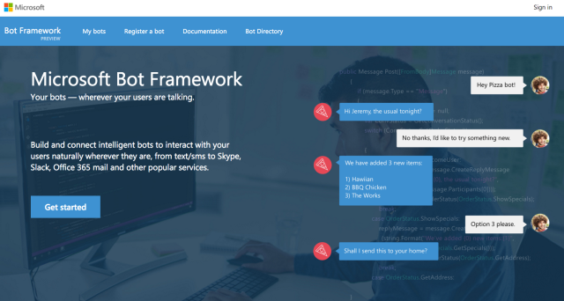
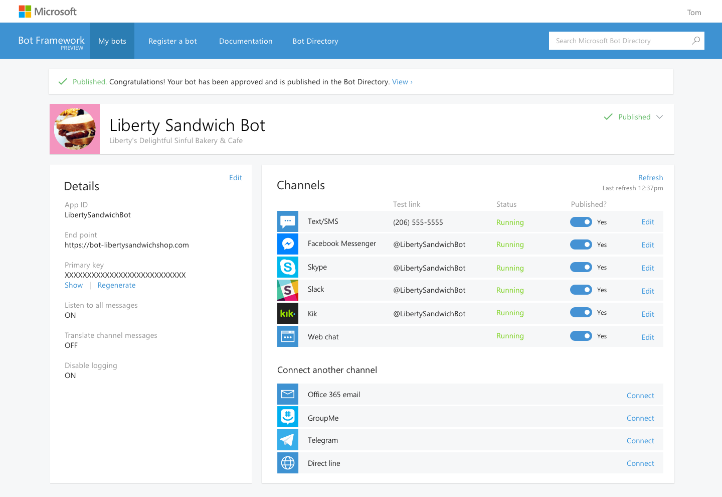
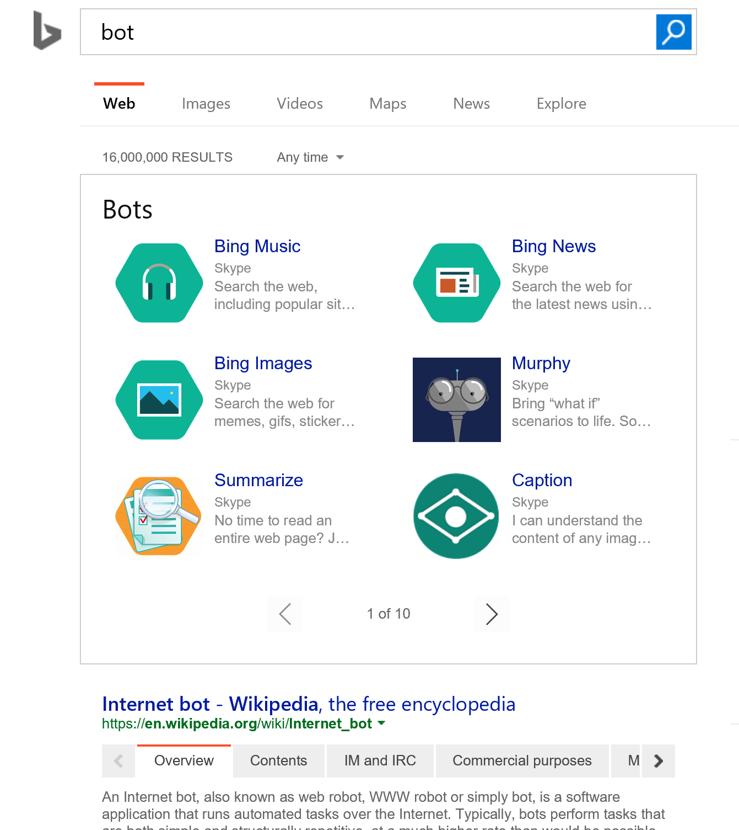
Microsoft Bot Framework Capabilities
Build once and publish your bots to the broadest set of channels your users are using
Bot Developer SDKs | Bot Channels | Bot Integration
Open source SDKs make it possible to bring your bot to life in minutes | Connect your bot to any or all of the top conversational experiences to reach >1B users | Integrate your bot with your existing applications such as ASP
Notes:
The Microsoft bot framework is the #1 bot framework in the market today. This framework provides 3 key capabilities for developers. This open source framework allows developers to build bots in the languages they know and love - .Net C# and node.js The framework provides connectors to over 15 different channels. This allows developers to build a bot once, and connect it to SMS, Email, Facebook, skype, slack, kik, web chat, etc. Finally, the framework allows you to publish bots to be discovered via search, Cortana and other web services. It is important to establish the skillsets of those who work at the company. From this perspective it can be established if the bot solution can be developed in-house or establish the level of support that is required for the project to succeed. Furthermore, understanding the differences between each channel that will be used for the bot.

Slide 25
Supporting Technologies
One-Turn FAQ
One-Turn Intelligent Response
Intelligent Notification
Multi-Turn Process Guidance
Contextual Guided Assistance
Multi-Turn Conversational Task Completion
Website FAQ
Context sensitive response
Contextual help
Password reset/Bookings
Status change alert
User preferences
QnA Maker
Proactive Messaging
Machine Learning
QnA Maker
Prompt Library
LUIS
Increasing complexity
Notes:
There are a range of supporting technologies that can be integrated into the bot framework to enhance and optimize the conversational flow. Understanding the capabilities of each technology is important as it can help you map a technology to a conversation pattern. The slide shows the mappings that can be used for conversational flow and technology.
QnA Maker - https://www.qnamaker.ai/
FormFlow - https://docs.microsoft.com/en-us/azure/bot-service/dotnet/bot-builder-dotnet-formflow
Proactive Messaging - https://docs.microsoft.com/en-us/azure/bot-service/bot-builder-howto-proactive-message?view=azure-bot-service-4.0&tabs=cs
LUIS - https://www.luis.ai/
Machine Learning - https://docs.microsoft.com/en-us/azure/machine-learning/
Cognitive Services - https://azure.microsoft.com/en-gb/services/cognitive-services/

Slide 26
Mapping Bot Capability to Organization Objectives
Notes:
In this section, you will explore examples of mapping Bot capability to organizational objectives, including:
* Microsoft Bot Logic Flow
* Bot Evolution Roadmap

Slide 27
Mapping Organizations Requirements
Define the Business Domain
Identify the business intents
Map conversational patterns to intents
Note any additional requirements
Notes:
The intention here is not to focus on the technology, but more on the business domain, intents and potential conversational flow. In addition, you can annotate the documentation to outline any additional requirements such as personalization. It is important to ensure that the format of the document is understood by the intended audience. Furthermore, this document is not fixed, and the expectation should be set with the customer that the initial findings could change with further investigation.

Slide 28
BOT EVOLUTION/ROADMAP
The following illustrates use cases selected for the Project (highlighted) as well as potential future use cases that can be considered to further evolve bot experience.
Current Scope
Scope v Next
Scope v Next+1
Booking Information
Agenda Information
Exhibitor Information
General Q&A
Notes:
The development of bots will likely be an evolution, not a revolution. It may not be possible to implement the solution in one release. It is therefore pragmatic to develop a roadmap of the functionality of the solution. The slide shows an example of a roadmap.

Slide 29
Language Understanding (LUIS)

Slide 30
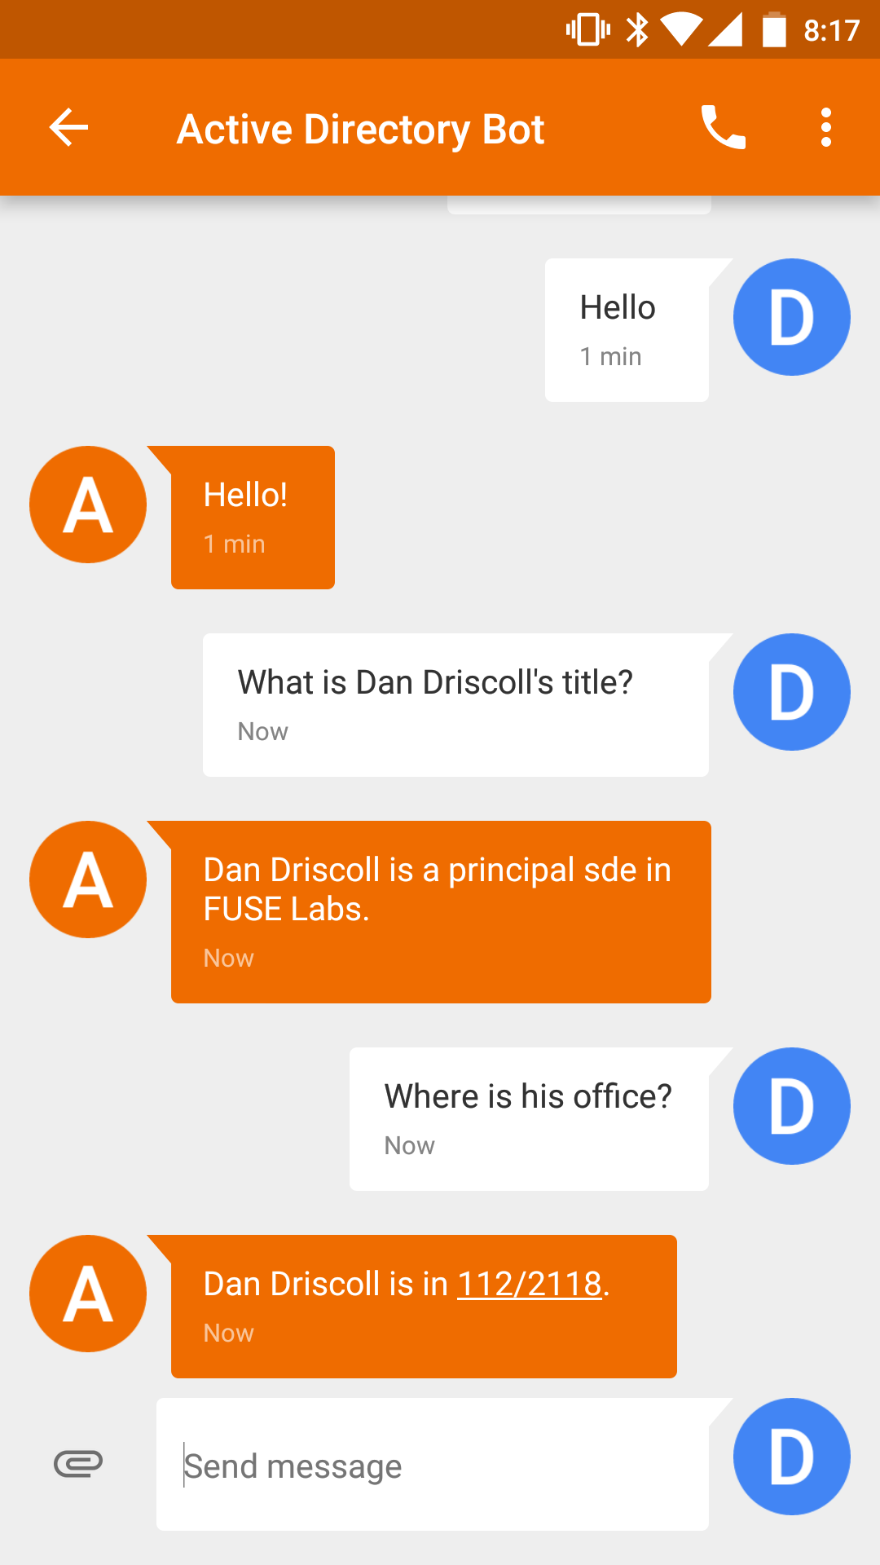
Natural Language Understanding (NLU) Engine
John
Sue
Erika
Who is _____?
Where does ____ work?
What is _____’s phone number?
Examples of intent detection
Examples of entity extraction
Source: Microsoft

Slide 31
Design Domains and Intents
Notes:
In this section, you will explore the steps required to design LUIS Domains and Intents, including:
1. Understanding LUIS Domain Options
2. Determining Intents
3. Bot Logic Flow – Intents
4. LUIS Intent Evolution/Roadmap

Slide 32
Understanding LUIS Domain Options
Pre-built Domain
Custom Domain
Hybrid
Notes:
A LUIS app is usually centered around a domain-specific topic. For example, you may have a travel app that performs booking of tickets, flights, hotels, and rental cars. Another app may provide content related to exercising, tracking fitness efforts and setting goals.
Language Understanding (LUIS) provides prebuilt domains, which are prebuilt sets of intents and entities that work together for domains or common categories of client applications. The prebuilt domains have been pre-trained and are ready for you to add to your LUIS app. You can find a full listing of the prebuilt domains in the Prebuilt domains reference. The intents and entities in a custom domain are fully customizable once you've added them to your app - you can train them with utterances from your system, so they work for your users. You can use an entire prebuilt domain as a starting point for customization, or just borrow a few intents or entities from a prebuilt domain.
The intents and entities in a prebuilt domain work best together. It's better to combine intents and entities from the same domain when possible. A best practice is to use related intents from the same domain. For example, if you are customizing the MakeReservation intent in the Places domain, then select the Cancel intent from the Places domain instead of the Cancel intent in the Events or Utilities domains.
* Tip
Check out the Utilities domain for prebuilt intents that you can customize for use in any domain. For example, you can add Utilities.Repeat to your app and train it to recognize whatever actions user might want to repeat in your application.
Alternatively, you can create your own domain with their own set of intents and entities.

Slide 33
Determining Intents
Here is a more detailed view of the Top Business Intents as LUIS intents.
Business Domain
Conference Management
Get video
Top Business Intents
Booking Information
Agenda Information
Exhibitor Information
General Q&A
LUIS Intents
Make Booking
Get agenda
Exhibitor.
How to Apply
General Q&A
Get Booking Balance
Get Booking Status
Exhibitor.
Levels
Reset Password
Booking Refund
None
Notes:
Think about the intents that are important to your application’s task. Let's take the example of a conference app, with functions to take bookings and check the agenda at the user's conference. You can define the "BookConference" and "GetAgenda" intents for these actions. In a more complex app with more functions, you will have more intents, and you should define them carefully so as to not be too specific. For example, “GetBookingBalance" and “GetBookStatus" may need to be separate intents, but “GetBookingBalance" and “GetBookStatus" may be too similar.
Using the None Intent.
The None intent is fallback for app. The None intent is a catch-all or fall back intent. It is used to teach LUIS utterances that are not important in the app domain (subject area).
None intent helps conversation direction. When an utterance is predicted as the None intent and returned to the bot with that prediction, the bot can ask more questions or provide a menu to direct the user to valid choices in the bot.
No utterances in None intent skews predictions. If you do not add any utterances for the None intent, LUIS forces an utterance that is outside the domain into one of the domain intents. This will skew the prediction scores by teaching LUIS the wrong intent for the utterance.
* NOTE
It is a best practice to use only as many intents as you need to perform the functions of your app. If you define too many intents, it becomes harder for LUIS to classify utterances correctly. If you define too few, they may be so general as to be overlapping.

Slide 34
Designing Entities
Notes:
In this section, you will explore the steps required to design entities, including:
Understanding Entities
Entity types

Slide 35
Understanding Entities
Entities are optional but highly recommended
Entities represent parameters or data for an intent
Entities are shared across intents
There are different types of entities
Hybrid
Notes:
* Entities are optional but highly recommended.
While intents are required, entities are optional. You do not need to create entities for every concept in your app, but only for those required for the app to act. If your utterances do not have details your bot needs to continue, you do not need to add them. As your app matures, you can add them later. If you are not sure how you would use the information, add a few common prebuilt entities such as datetimeV2, ordinal, email, and phone number.
* Entities represent data
Entities are data you want to pull from the utterance. This can be a name, date, product name, or any group of words. For example, in the utterance “Buy a ticket from New York to London on March 5”, three entities are used. Location.Origin, Location.Destination and Prebuilt datetimeV2 which would contain the value “New York”, “London” and “March 5” respectively.
* Entities are shared across intents
Entities are shared among intents. They don't belong to any single intent. Intents and entities can be semantically associated but it is not an exclusive relationship.
In the utterance "Book me a ticket to Paris", "Paris" is an entity of type location. By recognizing the entities that are mentioned in the user’s input, LUIS helps you choose the specific actions to take to fulfil an intent.
* Types of entities
LUIS offers many types of entities as shown in the next slide

Slide 36
Understanding Entity Types
Simple
List
Hierarchical
Composite
Hybrid
Notes:
Entities are important for accomplishing an intent. When you determine which entities to use in your app, keep in mind that there are different types of entities for capturing relationships between types of objects. The following entities exist:
Simple entity
A simple entity describes a single concept.
Hierarchical entity
A hierarchical entity represents a category and its members.
Composite entity
A composite entity is made up of other entities that form parts of a whole.
List entity
A list entity is an explicitly specified list of values. Each value consists of one or more synonyms. In a travel app, you might choose to create a list entity to represent airport names.
Prebuilt entity
LUIS provides prebuilt entities for common types like Number, which you can use for the number of tickets in a ticket order.
Other entities
Machine-learned entities work best when tested via endpoint queries and reviewing endpoint utterances.
Regular expression entities use the open-source Recognizers-Text project. There are many examples of the regular expressions in the /Specs directory for the supported cultures. If your specific culture or regular expression isn't currently supported, contribute to the project.
Exact-match entities use the text provided in the entity to make an exact text match.
Always think of the users perceive access for completing a task with your application or bot. Choosing a correct entity type could help your applications fulfil a user request more quickly and fulfill their needs.

Slide 37
Managing Utterances
Notes:
In this section, you will explore the practices for managing utterances, including:
1. Utterance Design Guidance
2. Improving Utterance Accuracy
3. Utterance Review Guidance

Slide 38
Utterance Design Guidance
Begin with 10-15 utterances per intent
Collect phrases that you think users will say
Use the representative language of the user
Include utterances that mean the same but are constructed differently.
Be mindful that utterances aren't always well formed
Choose varied terminology as well as phrasing
None intent should have between 10-20 % of the total utterances.
Hybrid
Notes:
Utterances are input from the user that your app needs to interpret. To train LUIS to extract intents and entities from them, it's important to capture a variety of different inputs for each intent. Active learning, or the process of continuing to train on new utterances, is essential to machine-learned intelligence that LUIS provides.
Collect phrases that you think users will say, and include utterances that mean the same thing but are constructed differently.
How to choose varied utterances
When you first get started by adding example utterances to your LUIS model, here are some principles to keep in mind.
Utterances aren't always well formed. It may be a sentence, like "Book me a ticket to Paris", or a fragment of a sentence, like "Booking" or "Paris flight." Users often make spelling mistakes. When planning your app, consider whether or not you spell-check user input before passing it to LUIS. The Bing Spell Check API integrates with LUIS. You can associate your LUIS app with an external key for the Bing Spell Check API when you publish it. If you do not spell check user utterances, you should train LUIS on utterances that include typos and misspellings.
Use the representative language of the user
When choosing utterances, be aware that what you think is a common term or phrase might not be to the typical user of your client application. They may not have domain experience. So be careful when using terms or phrases that a user would only say if they were an expert.
Choose varied terminology as well as phrasing
You will find that even if you make efforts to create varied sentence patterns, you will still repeat some vocabulary.
Take the following example utterances:
how do I get a computer?
Where do I get a computer?
I want to get a computer, how do I go about it?
When can I have a computer?
The core term here, "computer", is not varied. They could say desktop computer, laptop, workstation, or even just machine. LUIS intelligently infers synonyms from context, but when you create utterances for training, it's still better to vary them.
Example utterances in each intent
Each intent needs to have example utterances. If you have an intent but do not have any example utterances in that intent, you will not be able to train LUIS. If you have an intent with one or very few example utterances, LUIS will not be able to give accurate predictions.
Training utterances
Training is non-deterministic: the utterance prediction could vary slightly across versions or apps.
As a tool to help, you could use chatdown with V4 Emulator for designing sample conversations. The following video about using chatdown to plan conversations can be found at the following link https://channel9.msdn.com/Shows/AI-Show/Conversational-AI-Bot-Building-Tools

Slide 39
Improving Utterance Accuracy
Intent Utterance list:
Provides a list of example utterances for an intent.
Phrase List:
Enables synonyms to improve the accuracy of intent scores from an utterance
Pattern Features:
Improve accuracy for utterances that reveal a pattern in word order and word choice.
Regex:
Non machine learned technique using regular expressions to match information
Hybrid
Notes:
There are a number of features that you can use in your LUIS app to improve its accuracy with utterances to understand the intention of a users request. When making decisions on your LUIS design, you should consider which features can be used to improve the efficiency of utterances by making use of one, or a combination of the following features
Intent Utterance list
Provides the starting point with a list of example utterances for an intent. It is important to start the process with a list of example utterance for the intent you are wanting LUIS to interpret before exploring the other features to improve the accuracy.
Phrase Lists
Provides hints that certain words and phrases are part of a category. If LUIS learns how to recognize one member of the category, it can treat the others similarly. This improve the accuracy of intent scores and identify entities for words that have the same meaning (synonyms) by adding an interchangeable phrase list
Patterns
Patterns can be used to improve prediction accuracy of utterances by using entities and their roles to extract data using a specific pattern. This reduces the number of utterance example you would need to provide to teach LUIS about the common utterances for an intent, saving the time it would take to train your LUIS app while improving its’ accuracy.
Regex
These are non machine learned entities that matches information based on a regular expression that is defined. LUIS doesn't do the work and only determines what the user's intention is and extracts data about that intention.

Slide 40
Best Practices
Notes:
In this section, you will explore a summary of the following:
1. Best Practices.
2. Enterprise Considerations.

Slide 41
Best Practices
Intents
Create an intent when this intent would trigger an action.
Intents should be specific.
If intents are semantically close, consider merging them.
Entities
Create when bot needs some parameters or data from the utterance.
Utterances
Begin with 10-15 utterances per intent.
Each utterance should be contextually different.
The None intent should have between 10-20% of the total utterances
Hybrid
Notes:
Consider the following best practices
Intents
Create an intent when this intent would trigger an action.
Intents should be specific.
If intents are semantically close, consider merging them.
Entities
Create when bot needs some parameters or data from the utterance.
Utterances
Begin with 10-15 utterances per intent.
Each utterance should be contextually different.
The None intent should have between 10-20% of the total utterances

Slide 42
https://github.com/kwood-insight/LearnAI-Bootcamp 9:45-10:45AM (take breaks as needed) Tip: go slow, read carefully, don’t skip steps TIP: Make sure you create EchoBot NOT BasicBot in Portal
Lab 1: LUIS

Slide 43
Azure Search

Slide 44
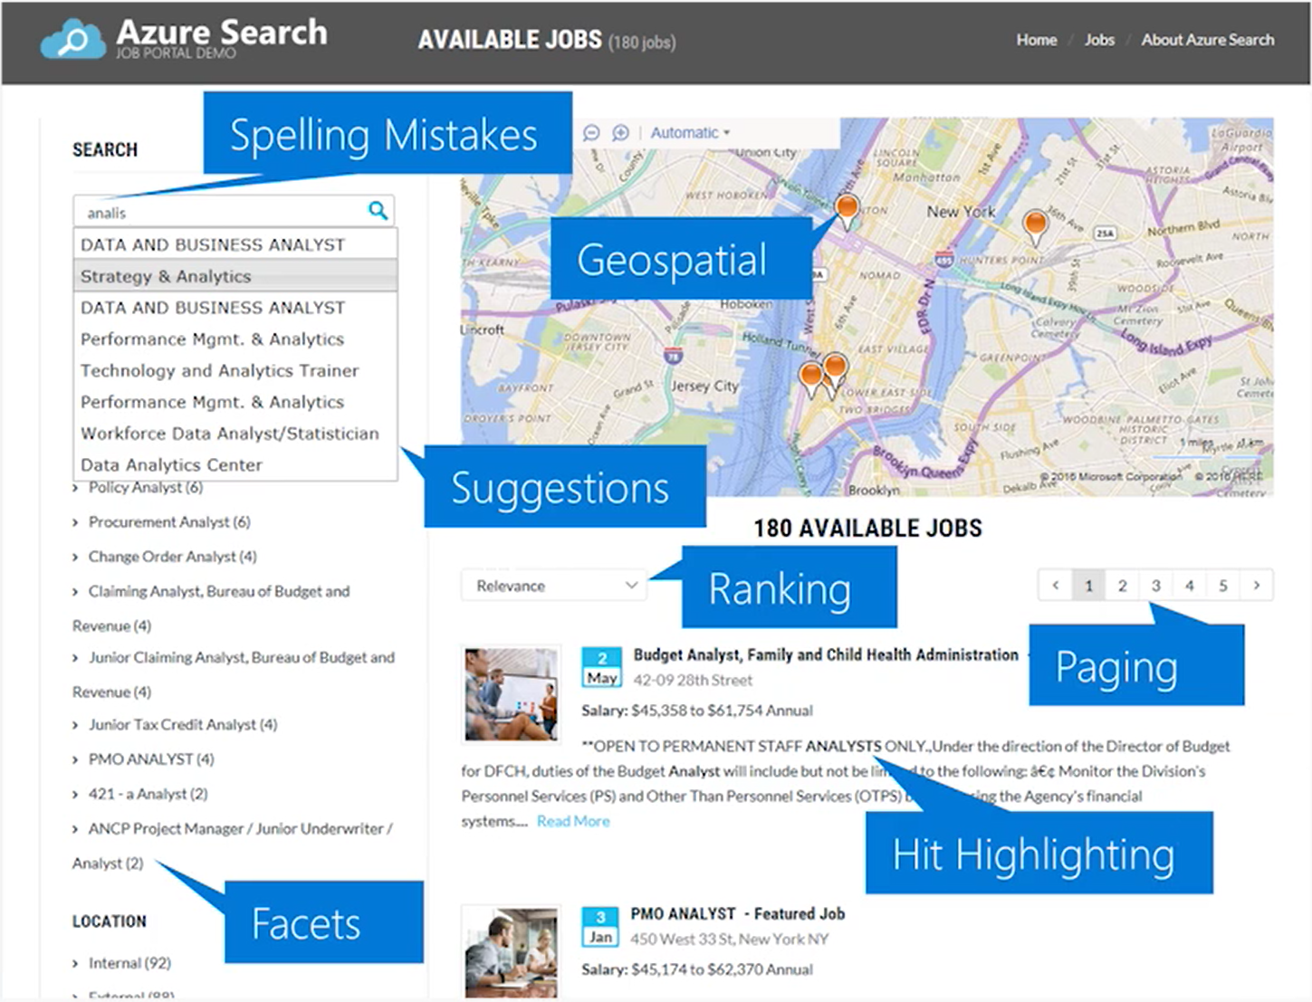
Azure Search
Notes:
Show flipkart
Azure Search is a search-as-a-service solution allowing developers to incorporate great search experiences into applications without managing infrastructure or needing to become search experts.
Developers look for PaaS services in Azure to achieve better and faster results in their apps. While search is a key to many types of applications, web search engines have set the bar high for search. Users expect: instant results, auto-complete as they type, highlighting hits within the results, great ranking, and the ability to understand what they are looking for, even if they spell it incorrectly or include extra words.
Search is a hard and rarely a core expertise area. From an infrastructure standpoint, it needs to have high availability, durability, scale, and operations. From a functionality standpoint, it needs to have ranking, language support, and geospatial capabilities.

Slide 45
Typical workflow
Provision service
Create an index
Index data
Search an index
Azure Search
Notes:
Show alice.unearth.ai
Typical Workflow:
Provision service
You can create or provision an Azure Search service from the portal or with PowerShell.
Create an index
An index is a container for data, think "table". It has schema, CORS options, search options. You can create it in the portal or during app initialization.
Index data
There are two ways to populate an index with your data. The first option is to manually push your data into the index using the Azure Search REST API or .NET SDK. The second option is to point a supported data source to your index and let Azure Search automatically pull in the data on a schedule.
Search an index
When submitting search requests to Azure Search, you can use simple search options, you can filter, sort, project, and page over results. You have the ability to address spelling mistakes, phonetics, and Regex, and there are options for working with search and suggest. These query parameters allow you to achieve deeper control of the full-text search experience.

Slide 46
https://github.com/kwood-insight/LearnAI-Bootcamp 11AM-12PM (take breaks as needed) Tip: go slow, read carefully, don’t skip steps
Lab 2: Azure Search

Slide 47
Creating Intelligent Bots

Slide 48
Effective Design Research
Notes:
In this section, you will explore the steps required to conduct effective design research, including:
1. Understanding the organizational requirements.
2. Understanding the types of conversation patterns.
3. Managing Bot States.
4. Building a personality profile for you bot.
5. Customer Story: Progressive.

Slide 49
Understanding the Organizations Requirements
Defining Objectives
Corporate Objectives
Transformation Objectives
Project Objectives
Objectives must meet:
Desirability Criteria
Feasibility Criteria
Viability Criteria
Establish Use Case/Scenario
Map out the Lifecycle/Workflow
Extrapolate high level domains/intents
Does the bot:
Solve a users issue with minimal steps.
Solve the issue better/easier or faster.
Run on platforms/devices the user cares for.
Make itself easy to be discovered and usable.
Notes:
During the design phase, it is typical to perform a discovery workshop on the requirements for implementing a bot for the organization. The purpose of the workshop is to establish the problem/use case that the bot is going to solve, assess the desirability, feasibility and viability criteria, and ensure that the specific use cases/bot conversational flows and intents are appropriately captured.
Desirability = includes the human factors (is there a human need for this innovation? Or are we making this bot for the sake of making a bot?)
Feasibility = technically feasible (is the technology available to actually do this?)
Viability = financially viable (is this sustainable from a business perspective)
Bots and Conversation as a Platform in general is a major technology shift and is considered a megatrend in the digital transformation space. Setting appropriate expectations, project goals and design guidelines are essential in ensuring that customers that embark on a conversation as a platform initiative drive the best value from their investment, and in-turn continue to build and grow their conversation platform initiative, driving future growth and continued end-user adoption.
It is important to dedicate the right amount of focus on design and not get deep into Bot Architecture, Toolkits and other tech-led conversations. This is not just a technology, it facilitates interaction, a human-to-computer interaction. It’s an experience! which is why we have UX and Architect leading the design conversations with other business stakeholders, including:
Project Sponsor and other business leaders that can speak to the desired outcome from the engagement and conditions of satisfaction
Business Domain experts specific to the scenario and use cases being explored with Bot.
Subject Matter experts that can speak to the knowledge domain and are familiar with the conversations we expert bots to have with end-users
Technical leads that understand the overall Systems Architecture of knowledge sources and can cover any aspect of backend knowledge/integration possibilities
Core Project team members, including Project Managers and Technical Consultants to ensure they are aligned with overall design requirements and business expectations.
The following are some general guidelines on running a workshop. These are harnessed through previous engagements conducted by the teams.
Start the discussion broadly with Design Led Thinking making sure Desirability, Feasibility and Viability criteria are top of mind.
Use existing logs/fact based analysis for driving towards top intents and key uses cases.
Use the Pareto Principle to make the cases if applicable
In a complete green-field scenario start by defining the personas and then use the lifecycle of the personas to identifying specific use-cases
Gauge the level of understanding around Bot terminologies in the audience and feel free to set the stage with key terms and taxonomies, this allows the audience to stay engaged during the workshop and not get lost in taxonomies.
Ultimately, it does not matter how “smart” a bot is, or whether it supports a rich natural language that interacts with your users seamlessly. The design phase should attempt to answer the following questions:
Does the bot easily solve the user’s problem with the minimum number of steps?
Does the bot solve the user’s problem better/easier/faster than any of the alternative experiences?
Does the bot run on the devices and platforms the user cares about?
Is the bot discoverable? Do the users naturally know what to do when using it?
A great bot user experience does not require users to type too much, talk too much, repeat themselves several times, or explain things that the bot should automatically know.

Slide 50
Conversation patterns
One-Turn FAQ
One-Turn Intelligent Response
Intelligent Notification
Multi-Turn Process Guidance
Contextual Guided Assistance
Multi-Turn Conversational Task Completion
Website FAQ
Context sensitive response
Contextual help
Password reset/Bookings
Status change alert
User preferences
Increasing complexity
Notes:
While working on defining use cases, there is a varying level of complexity involved with certain types of conversational flows. For example, a one-turn dialog that is simply responding by pairing an answer to a question (or set of questions) is a low complexity use case. A multi-turn dialog that needs to extract multiple entities, has to remain context sensitive and is doing some type of task completion which also requires backend integration is a high complexity use case. Then there are other patterns that fall somewhere in between these two extremes. To manage priorities across use cases and overall acceptance criteria for the project, within the constraints of the project scope, it is important to bring in a complexity discussion while walking through the use cases.
One way to manage these conversations is by defining a set of conversational patterns that are organized by the level of complexity where each use case, as it is discovered, is mapped to one of those conversational patterns. These can be organized as follow:
One-Turn FAQ These are general FAQ style answers that is based on one-turn responses.
Intelligent Notification This is a notification pattern because it is not in response to any query initiated by the user. Design guidance suggests caution when it comes to the bot providing proactive notification.
One-Turn Intelligent Response These are also one-turn responses which don’t typically have a follow-up or additional conversational flow. These are “intelligent” terms as they need to be provided within the context of a conversation or activity. For example, a customer may ask, what time does flight XX065 leave LAX today?
Contextual Guided Assistance In this scenario, context is associated with the page/url the user is on as opposed to who the user is and would like the bot to be able to answer questions within this context of the page/url.
Multi-Turn Process Guidance This is a unique scenario within the users domain - there are a number of process flows established that a bot can be enabled to do a user walk-through. While these are multi-turn dialog scenarios, they are not truly conversational as the user responses are restricted to Yes/No only with potentially an option to opt out or cancel the guided assistance.
Multi-Turn Conversational Task Completion This is a multi-turn conversational pattern typically leading to a task completion scenario. In this type of pattern, the user is not restricted to fixed responses and can potentially provide free-form natural language response. The bot will need to interpret this within the context of the process the user is in.

Slide 51
BOT LOGIC FLOW – Intents
Here is a high level logic flow for the bot starting with Top Intents.
LUIS Domain
Event Pre-built Domain with added custom intents and entities
Top Intents
(LUIS)
Make Booking (PBI)
Get agenda
Get Booking Balance
Get Booking Status
Booking Refund
Exhibitor.
How to Apply
Reset Password
General Q&A
None
One-Turn Intelligent Response
Dialogs
One-Turn Intelligent Response
Dialogs
One-Turn Intelligent Response
Dialogs
Multi-Turn Process Guidance
Dialogs
Conversation Patterns
Multi-Turn Process Guidance
Dialogs
Multi-Turn Conversational Task Completion
Personalized follow up notification specific to the response
(e.g. “of course.” if Booking = True)
Multi-Turn Conversational Task Completion
Annotations
One-Turn FAQ
(Processed by QnA maker)
One-Turn FAQ
(Processed by QnA maker)
Additional Intents
(Non-LUIS)
Greeting
Closing
QnA Confidence Logic
0.3 or less (Closing dialog)
0.3-0.5 (Confirm dialog)
0.5 and above (Respond)
Personalized Notification Using Regex
Notes:
The slide shows an example of how you can map the use case intents to a conversation flow in more detail. The starting point for this diagram is from the Bot Logic Flow – High Level design. The intention here is to focus on the conversational flow and you can start to add the supporting technology. In addition, you can annotate the diagram to outline any logic for determining responses and personalization. The Logic Flow does not have to use this format, but it is important to ensure that the format is understood by the intended audience.
You could use the tool LUDown to help in the planning of LUIS models.

Slide 52


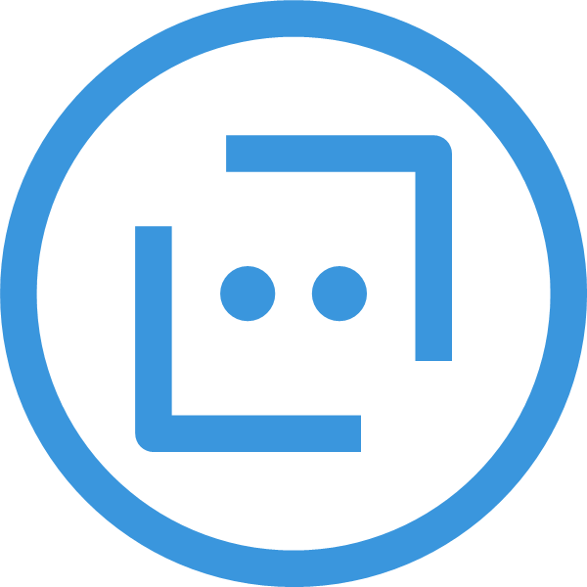
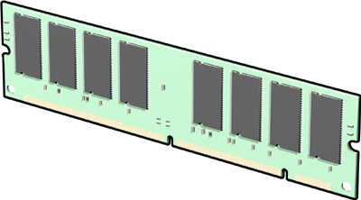

Managing Bot States
Stateless data
Maintaining State data
User Properties
Conversation Properties
Notes:
A key to good bot design is to track the context of a conversation, so that your bot remembers things like the answers to previous questions. This is known as Bot State Management. The Bot Builder SDK provides classes for storing and retrieving state data as an object associated with a user or a conversation.
Conversation properties help your bot keep track of the current conversation the bot is having with the user. If your bot needs to complete a sequence of steps or switch between conversation topics, you can use conversation properties to manage steps in a sequence or track the current topic. Since conversation properties reflect the state of the current conversation, you typically clear them at the end of a session when the bot receives an end of conversation activity.
User properties can be used for many purposes, such as determining where the user's prior conversation left off or simply greeting a returning user by name. If you store a user's preferences, you can use that information to customize the conversation the next time you chat. For example, you might alert the user to a news article about a topic that interests her or alert a user when an appointment becomes available. You should clear them if the bot receives a delete user data activity.
The SDK provides bot state manager middleware to persist conversation and user state. State can be accessed using the bot's context. This state manager can use Azure Table Storage, file storage, or memory storage as the underlying data storage. You can also create your own storage components for your bot.
Bots built using Azure Table Storage can be designed to be stateless and scalable across multiple compute nodes.
https://docs.microsoft.com/en-us/azure/bot-service/bot-builder-storage-concept?view=azure-bot-service-4.0

Slide 53

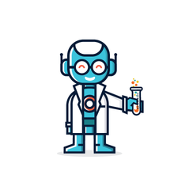



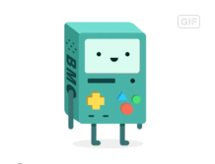
CHATBOT Personality Profile – It represents your brand after all.
AGE
OCCUPATION
RESIDENCE
USER-LEVEL
35
Associate Agent
Manchester
lower-mid (~4 years)
GOALS
Assist attendees with booking onto a conference
Answer conference related Q&A
Assist customers with finding video and slide resources of sessions at previous conferences
PERSONALITY
TARGET USERS
The personality profile is designed to targets the following user profiles.
Attendees of the conference
Non attendees viewing videos
Exhibiters of a conference
Extrovert
Introvert
Sensing
Intuition
BIO
BitBot has a few years of experience under his belt when it comes to working with data. As an employee he can point to the right videos and resources by reacting quickly and professionally to attendees needs and requests.
Thinking
Feeling
Judging
Perceiving
PAIN POINTS
Lack of understanding
Request complexity
Unclear expectations
CHARACTER
Experienced & Active
Helpful & Courteous
Straightforward & Urgent
Professional & Savvy
SAMPLE AVATARS
This information impacts the LUIS Schema design. More in the next module
Replace with Customer Logo
Notes:
Would you trust someone not in your organization to speak on behalf of your organization?
Your bot is going to be the spokesperson for your company. That’s why it is important to have a mix of business stakeholders ranging from UX leads, project owners and other stakeholders in the design phase of the bot. Most customers are looking at either knowledge orientated or task completion bots and expect bots to be able to answer general knowledge questions, integrating that is not a big deal if you use knowledge search. What is often overlooked is the personality of the bot. Personality makes a difference, even if it’s in subtle ways. Remember that it will be representing your brand and as such it is important to consider the personality profile so that it represents your company at its’ best.
Options to consider when defining a bot personality profile include:
Demographics
BIO
Goals of the bot
Pain Points of the bot
Personality
Character
Target users

Slide 54
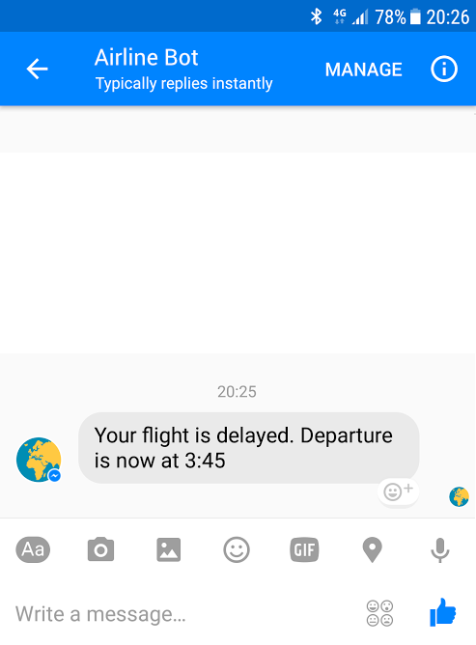
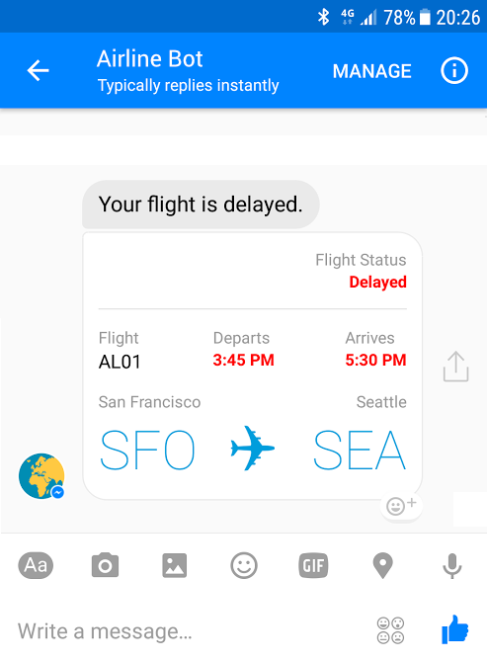
Conversational mechanisms

Slide 55

Conversational mechanisms
Text, with optional media attachments
Traditional chat can contain media attachments
(e.g., image, video, audio, file)
Input prompts
Suggested actions: Buttons, numbered items in a list, etc.
Rich cards, rendered as a list or carousel
Images, buttons, audio, animations, video, user sign-in, etc.
Speech
Text-based chat using Speech Recognition & Synthesis (TTS)
Notes:
Most successful apps or websites have at least one thing in common: a great user experience. Bots are no different in that regard. Therefore, ensuring a great user experience should be your number one priority when designing a bot. Some key considerations include:
Does the bot easily solve the user’s problem with the minimum number of steps?
Does the bot solve the user’s problem better/easier/faster than any of the alternative experiences?
Does the bot run on the devices and platforms the user cares about?
Is the bot discoverable? Do the users naturally know what to do when using it?
Note that none of these questions directly relates to factors such as how smart the bot is, how much natural language capability it has, whether it uses machine learning, or which programming language was used to create it. Users are unlikely to care about any of these things if the bot solves the problem that they need to address and delivers a great user experience. A great bot user experience does not require users to type too much, talk too much, repeat themselves several times, or explain things that the bot should automatically know.

Slide 56
Customer Story
TD Ameritrade

Slide 57

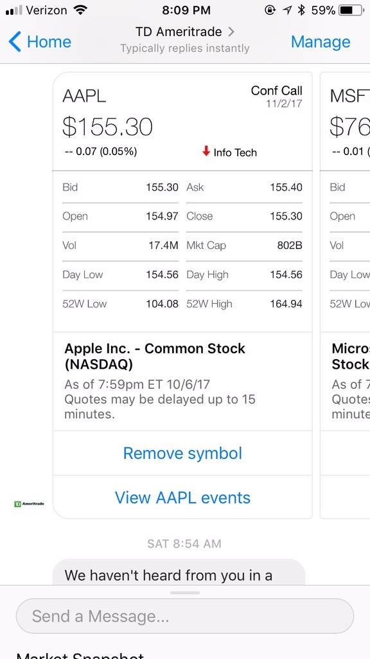
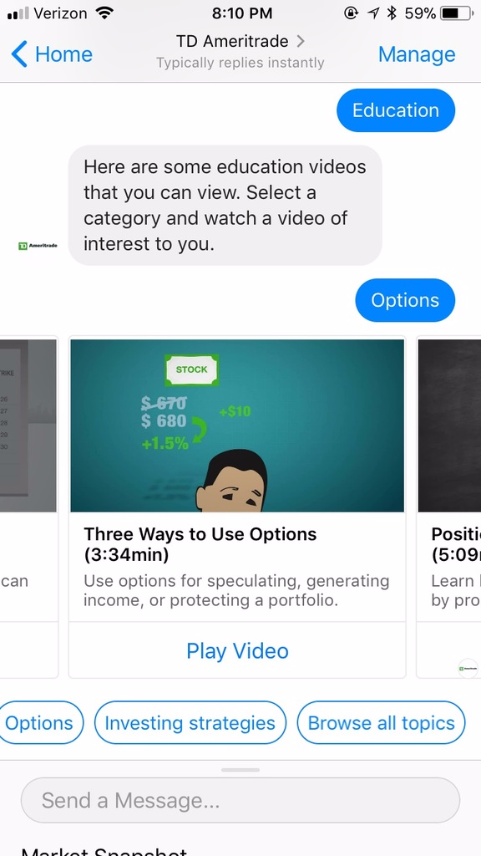

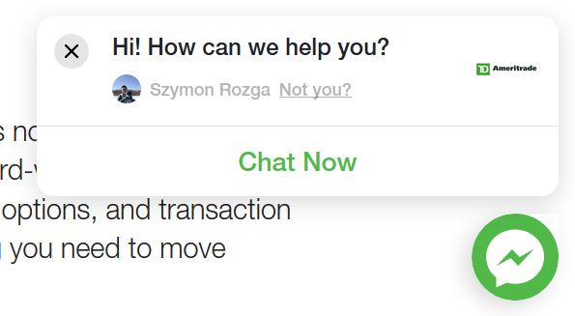
Personal Financial Assistant
TD Ameritrade was looking to engaged with customers on the platforms of their choice via innovative, artificial intelligence driven conversations.
Insight Digital Innovation designed and built a conversational agent that integrates with TDA’s retail brokerage services including money movement, trading and education across over five channels and multiple languages.
Notes:
Background
TD Ameritrade is a brokerage firm based in Omaha, Nebraska. The letters TD are derived from Toronto-Dominion Bank, the largest shareholder. The company provides services for individuals and institutions that are investing online. Insight DI has had a relationship with TD Ameritrade for over six years, working on everything from Windows 8 and10 apps to iOS and Android mobile apps.
Situation
TD Ameritrade had developed a simple Alexa skill in 2016. We engaged in a conversation about the different chat bot implementations we have put together with their innovation group. We agreed that a chat bot on a platform like Facebook Messenger is something the company would deploy. Our technical stakeholders brought on the head of social, who became the business sponsor.
The initial goal of the project was to showcase TDA as an innovative brand that appealed to the younger generations of traders and met their users on the social channels as much as on their own web and mobile properties. The secondary goals were to automate some of the responses to ease the burden off their CSR team, monetize by enabling transactions and easy money movement and to intelligently surface their growing library of education content that was no longer accessibly only to paying members.
Solution Vision
Insight DI worked with TDA to build a chat bot hosted on Azure that integrated with a variety of APIs and channels to bring this vision to life. The first version of the chat bot integrated with a live chat platform called In The Chat, (ITC) to provide live chat escalation on Facebook Messenger. Since the CSR team already used this platform, Insight worked with the ITC team to develop the right hooks for ITC to support chat bots and reporting by intelligently opening/closing cases in the ITC platform.
The initial version of the chat bot supported features such as quotes, events, research, news, education videos, FAQ and account login via Oauth (first application to use TDA’s new Oauth implementation), positions, balances and orders. Subsequent releases of the chat bot added additional channel, language and feature support. Insight added support for Twitter DM, Alexa, Apple Business Chat and WeChat. The project does not utilize any of the Microsoft Channel Connectors; all channel integration is custom for control and live chat integration purposes. The team has built support for US English, British English, Simplified and Traditional Chinese. Additional features included trading, money movement, education content and quizes, new account onboarding, migration of Scottrade accounts into TDA, twitter social data and human handover UX optimizations. The chat bot integrates with internal TDA APIs, Brightcove for video content, LifeFolio for social financial content,
The chat bot runs on an Azure App Service connected to Cosmos DB for bot state, Redis for caching/inter process locking, Blob Storage for dynamically rendered content storage, Application Insights for detailed telemetry tracking, LUIS for Natural Language Understanding and QnA Maker for cross-channel, rich FAQ. LUIS and QnA Maker were used in novel ways to accomplish the appropriate level of scale. The project uses the LUIS dispatcher model approach and uses a total of five LUIS models per environment per language. The team built a series of dev ops scripts based on Microsoft’s BotBuilder Tools that allow LUIS model management using .lu files in git for easy diff tracking and version management. QnA Maker contains rich structured data around content for each channel, linking between content and multi-language support. To generate dynamic graphics, the team created a standalone ASP.Net Core web service that uses the puppeteer node package to run Headless Chrome rendering standards complaint HTML/CSS/JavaScript into PNG images in less than 250ms.

Slide 58
https://github.com/kwood-insight/LearnAI-Bootcamp 1-3PM (take breaks as needed) Tip: go slow, read carefully, don’t skip steps TIP: Make sure you create EchoBot NOT BasicBot in Portal
Lab 3: Building Intelligent Bots

Slide 59
https://github.com/kwood-insight/LearnAI-Bootcamp 3-4PM (take breaks as needed) Tip: go slow, read carefully, don’t skip steps
Lab 4: Enhancing Applications with Bing Search

